Slide 1
Extensive Form Games
INFO 4220 – Networks II: Market Design

Slide 2
Topics so far
Matching Problems
Assignment Problems
Matching people to people
One-to-one matching (musician-singer)
Many-to-one matching (medical residence)
Matching people to objects
One-to-one assignment (dorm rooms)
  Public, private, mixed endowments
Probabilistic assignments
School choice
Course allocation
Kidney exchange

Slide 3
Coming next
We are going to look at problems where there is exchange of money
Auction Theory
Auctions in Online Advertising
Auctions in Financial Markets
Before we can talk about auction theory, we need some game theory that will be useful to analyze how people’s actions

Slide 4
Backward Induction
In sequential games, it makes sense to analyze the game from the end to the beginning
You identify the outcome that you want to reach, and then plan your actions backwards to make sure you get to that outcome

Slide 5
The Centipede Game
Consider the following game between 2 players:
Player A has two piles of coins in front of them: One with 3 coins, and the other with 1 coin. They have to choose:
  Taking the big pile and giving the small pile to player B (game ends)
  Or passing both piles to the other player
Whenever the coins are passed, one coin is added to each pile. The player that received the piles gets to decide whether to take the larger pile and giving the small to the other player, or passing both
Game ends in round 100, or when someone takes the pile
Imagine you are player 1, what would you do? (I am going to ask you in PollEV)

Slide 6
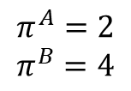
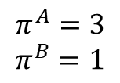
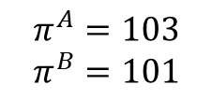
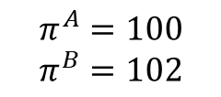
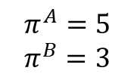
Centipede Game
Decision set
1 (A moves)
Starting node
Pass
Take
Decision nodes
2 (B moves)
Branches
$$π^{A}=3$$
$$π^{B}=1$$
Pass
Take
3 (A moves)
$$π^{A}=2$$
$$π^{B}=4$$
Pass
Take
Payoffs
100 (B moves)
$$π^{A}=5$$
$$π^{B}=3$$
Pass
Take
$$π^{A}=100$$
$$π^{B}=102$$
$$π^{A}=103$$
$$π^{B}=101$$

Slide 7
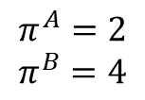
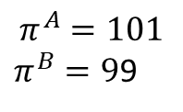
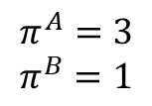
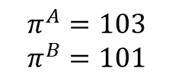
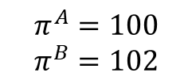
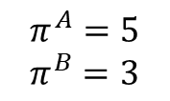
Centipede Game
1 (A moves)
Pass
Take
2 (B moves)
$$π^{A}=3$$
$$π^{B}=1$$
Pass
Take
3 (A moves)
$$π^{A}=2$$
$$π^{B}=4$$
Pass
Take
$$π^{A}=5$$
$$π^{B}=3$$
99 (A moves)
Pass
Take
100 (B moves)
$$π^{A}=101$$
$π^{B}=9$9
Pass
Take
$$π^{A}=100$$
$$π^{B}=102$$
The last move would be made by player B, what will she do?
Take
Pass
$$π^{A}=103$$
$$π^{B}=101$$

Slide 8
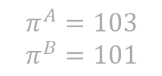
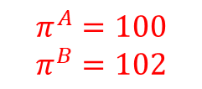
Centipede Game
1 (A moves)
Pass
Take
2 (B moves)
$$π^{A}=3$$
$$π^{B}=1$$
Pass
Take
3 (A moves)
$$π^{A}=2$$
$$π^{B}=4$$
Pass
Take
$$π^{A}=5$$
$$π^{B}=3$$
99 (A moves)
Pass
Take
In round 99 it is player’s A turn. Player A should know that if he passes, then in round 100 player B is going to take. Thus, what should player A do in round 99?
A) Take
B) Pass
100 (B moves)
$$π^{A}=101$$
$π^{B}=9$9
Pass
Take
$$π^{A}=100$$
$$π^{B}=102$$
$$π^{A}=103$$
$$π^{B}=101$$

Slide 9
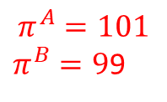
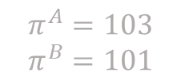
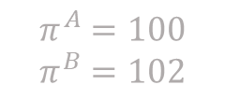
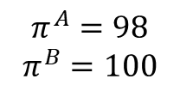
Centipede Game
1 (A moves)
Pass
Take
2 (B moves)
$$π^{A}=3$$
$$π^{B}=1$$
Pass
Take
3 (A moves)
$$π^{A}=2$$
$$π^{B}=4$$
Pass
Take
98 (B moves)
$$π^{A}=5$$
$$π^{B}=3$$
Pass
Take
99 (A moves)
In round 98 it is player’s B turn. Player B should know that if he passes, then in round 99 player A is going to take. Thus, what should player B do in round 98?
A) Take
B) Pass
$$π^{A}=98$$
$$π^{B}=100$$
Pass
Take
100 (B moves)
$$π^{A}=101$$
$π^{B}=9$9
Pass
Take
$$π^{A}=100$$
$$π^{B}=102$$
$$π^{A}=103$$
$$π^{B}=101$$

Slide 10
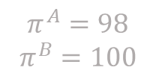
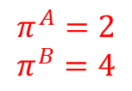
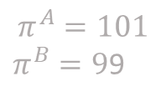
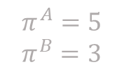
Centipede Game
1 (A moves)
Pass
Take
2 (B moves)
$$π^{A}=3$$
$$π^{B}=1$$
Pass
Take
3 (A moves)
$$π^{A}=2$$
$$π^{B}=4$$
Pass
Take
98 (B moves)
$$π^{A}=5$$
$$π^{B}=3$$
Pass
Take
99 (A moves)
$$π^{A}=98$$
$$π^{B}=100$$
We can keep doing this until we reach round one. What should player A do (knowing that whoever plays next is going to take)?
A) Take
B) Pass
Pass
Take
100 (B moves)
$$π^{A}=101$$
$π^{B}=9$9
Pass
Take
$$π^{A}=100$$
$$π^{B}=102$$
$$π^{A}=103$$
$$π^{B}=101$$

Slide 11
Backward Induction
To determine the equilibrium in an extensive form game you work by backward induction
You need to assume that players: Are rational and they know the structure, the rules, and the payoffs of the game
The problem is that with long and complicated games, the assumption is not very realistic
Often this type of equilibrium doesn’t match very well what happens in the real world

Slide 12
Chess Players vs College Students
Palacios-Huerta and Volik (2009) did an experiment where the make professional chess players and college students play this game:
High ranked chess players end the game sooner
All grandmaster chess players end the game in round 1
When chess players played against non-chess players, they let the game go for longer
In long games:
  It is difficult to do the backward reasoning
  A sophisticated player can take the advantage of the (lack of) ability of the other player to make inductive reasoning

Slide 13
Market Entry Game
In a market there is only one incumbent firm (let’s call it B). A challenger (let’s call it A) is deciding whether to enter or not. Entering has a cost of 1 (that B already paid)
If A decide to enter, the incumbent can respond in two ways:
Exit: In which case A wins 3 and B loses 1
Stay: In which case both firms lose 2
If A decide to not enter, the incumbent can respond in two ways:
Exit: In which case A wins 0 and B loses 1
Stay: In which case A wins 0 and B wins 3

Slide 14
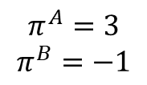
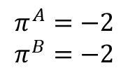
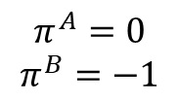
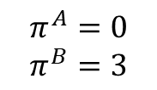
Market Entry Game
I (A moves)
Enter
Not Enter
II_{E} (B moves)
II_{N} (B moves)
Stay
Exit
Stay
Exit
$$π^{A}=−2$$
$$π^{B}=−2$$
$$π^{A}=3$$
$$π^{B}=−1$$
$$π^{A}=0$$
$$π^{B}=3$$
$$π^{A}=0$$
$$π^{B}=−1$$
Market entry game:
B is an incumbent (firm already in the market)
A is a potential entrant. To enter, it has to spend 1 (which is a sunk cost that B already paid)
There isn’t room for two firms in the market to be profitable

Slide 15
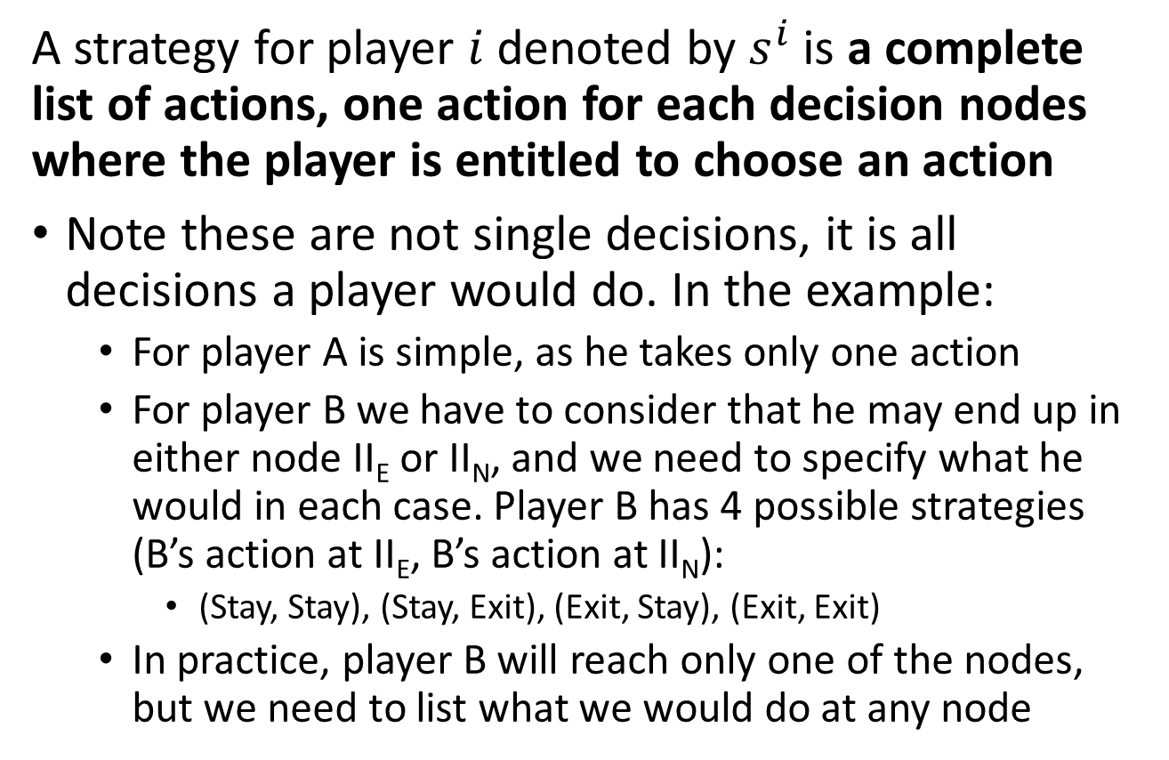
Definition of a Strategy
A strategy for player $i$ denoted by $s^{i}$ is a complete list of actions, one action for each decision nodes where the player is entitled to choose an action
Note these are not single decisions, it is all decisions a player would do. In the example:
  For player A is simple, as he takes only one action
  For player B we have to consider that he may end up in either node II_{E} or II_{N}, and we need to specify what he would in each case. Player B has 4 possible strategies (B’s action at II_{E}, B’s action at II_{N}):
    (Stay, Stay), (Stay, Exit), (Exit, Stay), (Exit, Exit)
  In practice, player B will reach only one of the nodes, but we need to list what we would do at any node

Slide 16
Outcome of the Game
The outcome of the game list of all of the actions taken by each player at every possible node that the player is entitled to choose an action:
  (A’s action at I, (B’s action at II_{E}, B’s action at II_{N}))
The game has 8 possible outcomes
  (Enter, (Stay, Stay)), (Enter, (Stay, Exit))
  (Enter, (Exit, Stay)), (Enter, (Exit, Exit))
  (Not Enter, (Stay, Stay)), (Not Enter, (Stay, Exit))
  (Not Enter, (Exit, Stay)), (Not Enter, (Exit, Exit))

Slide 17
Representing Extensive Form Games in Normal Form
I (A moves)
Enter
Not Enter
II_{E} (B moves)
II_{N} (B moves)
Stay
Exit
Stay
Exit
$$π^{A}=−2$$
$$π^{B}=−2$$
$$π^{A}=3$$
$$π^{B}=−1$$
$$π^{A}=0$$
$$π^{B}=3$$
$$π^{A}=0$$
$$π^{B}=−1$$
(A’s action at I, (B’s action at II_{E}, B’s action at II_{N}))
The game has 8 possible outcomes
  (Enter, (Stay, Stay)), (Enter, (Stay, Exit))
  (Enter, (Exit, Stay)), (Enter, (Exit, Exit))
  (Not Enter, (Stay, Stay)), (Not Enter, (Stay, Exit))
  (Not Enter, (Exit, Stay)), (Not Enter, (Exit, Exit))

Slide 18
Finding an Equilibrium
A technique that can be used to find N.E. in extensive form games is to represent them in normal form. In the example this would be:
Firm A | Firm B
 |  | (Stay, Stay) | (Stay, Exit) | (Exit, Stay) | (Exit, Exit)
 | Enter | (-2, -2) | (-2, -2) | (3, -1) | (3, -1)
 | Not Enter | (0, 3) | (0, -1) | (0, 3) | (0, -1)

Slide 19
Finding an Equilibrium
A technique that can be used to find N.E. in extensive form games is to represent them in normal form. In the example this would be:
Firm A | Firm B
 |  | (Stay, Stay) | (Stay, Exit) | (Exit, Stay) | (Exit, Exit)
 | Enter | (-2, -2) | (-2, -2) | (3, -1) | (3, -1)
 | Not Enter | (0, 3) | (0, -1) | (0, 3) | (0, -1)
The problem is that this usually leads to multiple N.E., which isn’t very helpful to predict an outcome

Slide 20
Subgame Perfect Equilibria
While in the normal form there are 3 N.E., there are two that just don’t make sense
The N.E. concept does not consider that firm A in its first move can foresee the actions of firm B and obtain a first mover advantage
The concept of Subgame Perfect Equilibria solves this problem
A subgame is a decision node from the original game along with the decision nodes and terminal nodes directly following this node.
A subgame is called a proper subgame if it differs from the original game

Slide 21
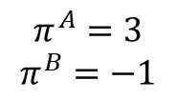
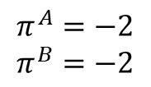
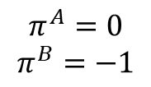
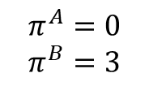
Subgame Perfect Equilibria
The entry/exit game has three subgames: The game itself (which is not a proper subgame), and the two subgames that can be formed with nodes II_{E} and II_{N}
II_{E} (B moves)
II_{N} (B moves)
Stay
Exit
Stay
Exit
$$π^{A}=−2$$
$$π^{B}=−2$$
$$π^{A}=3$$
$$π^{B}=−1$$
$$π^{A}=0$$
$$π^{B}=3$$
$$π^{A}=0$$
$$π^{B}=−1$$
These are the two proper subgames of the entry/exit game
An outcome is a subgame perfect equilibria (SPE) if it induces a N.E. in every subgame of the original game

Slide 22
Subgame Perfect Equilibria
In the entry/exit game, the outcome (Enter, (Exit, Stay) is a unique subgame perfect equilibria
  We know (Enter, (Exit, Stay)) is a N.E. in the full game
  For subgame II_{E}, Exit is the N.E.
  For subgame II_{N}, Stay is the N.E.
  Thus, the outcomes (Enter, (Exit, Exit)) and (Not Enter, (Stay, Stay)) are not SPE
How do you find the subgame perfect equilibria?
  Using backward induction!

Slide 23
Take Away
Games in Extensive Form – Sequential moves
  We represent extensive form games in trees
  We can also represent them in normal form and find the N.E. in this way. But N.E. is not very useful.
  Solving the game by backward induction is going to give us the subgame perfect equilibria of the game
We are doing this because it will be useful for analyzing what people do in auctions

